Slide 1
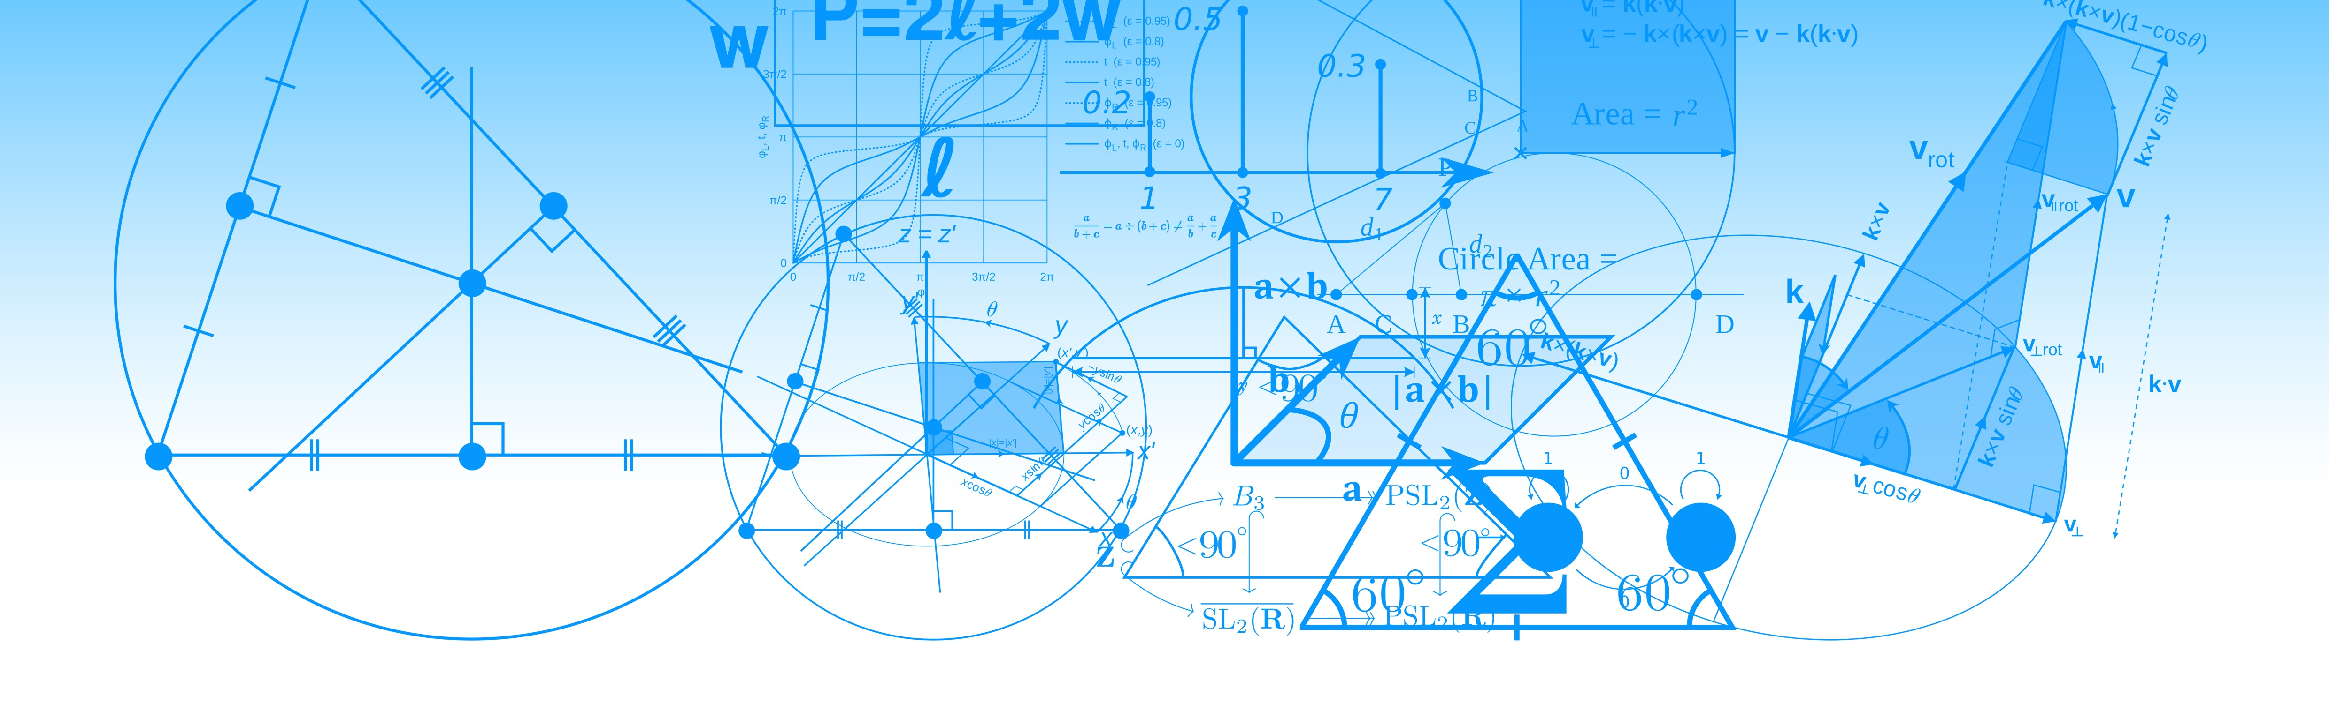
STRATEGY TEMPLATE
Our Fleet Data Strategy

Slide 2
Our Data Challenge
It’s about more than just the data itself.
Our fleet is critical and expensive – one of our largest assets.
We effectively capture fleet and driver performance data.
We’re able to analyze our data to spot trends and anomalies.
OUR CHALLENGE
How do we use this information to drive productivity & safety?
| Data Strategy Template

Slide 3
DATA STRATEGY ELEMENTS
Fleet Management
Data Strategy Template
Manager Involvement
Prioritization
Effective Communication
Reasonable
Goals
Reporting
Accountability
Recognition
| Data Strategy Template

Slide 4
Prioritize
We cannot fix everything at once.
1
Productivity
2
Customer Service
3
Idle Times
4
Fuel Usage
5
Safety
| Data Strategy Template

Slide 5
Idle Time
Fuel waste reduction plan.
FUEL WASTE
Excessive Idling wastes fuel and drives up costs.
IDLE TIME REPORTS
Run weekly idle time reports, by driver
IDLE TIME GOALS
Set reasonable goals based on industry, etc.
POST RESULTS
Post your leaderboard so everyone can see.
INVOLVE MANAGERS
Have managers directly congratulate good drivers
SAVINGS TOTALS
Post total cost savings – success is contagious.
RECOGNITION Recognize top performers lowest times, etc.
| Data Strategy Template

Slide 6
Safety & Accident Reduction
Our-6 point plan.
Let drivers know we want them to be safe
We will set reasonable goals for speeding, seatbelt usage, etc.
We will run safety reports, by driver, on a weekly basis
Results will be posted prominently
Top safety performers will be recognized by the exec committee
Managers to meet with top drivers to congratulate (and counsel poor ones)
| Data Strategy Template

Slide 7
Communication Plan
Engage each of these people.
CEO – Buy-in at the top
CIO – For reports and posting
Customer Service Manager
Fleet Manager
Safety Manager
Maintenance Manager
Drivers
| Data Strategy Template

Slide 8
Fleet Data Strategy
Keys to effectively putting our data to work.
Reasonable Goals
Post Results Regularly
Recognize Top Performers
Counsel Poor Performers
1
2
3
4
| Data Strategy Template

